Slide 1
WW1
(1914-1918)

Slide 2
The Main Causes of WW1
Militarism
Alliances
Imperialism
Nationalism
Significant (or Stupid) individuals!
***Remember this! It may be on a test (hint hint!)

Slide 3

Lets go back a bit.
Lets take a look at the empires that existed before WW1.
Question – What is an empire?
and
Who runs them?

Slide 4
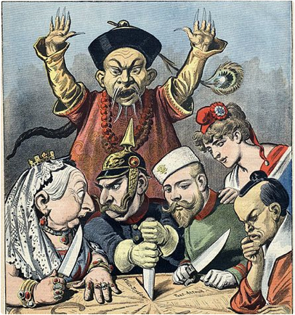
Empire building
Before WW1 there were some countries in Europe who madly scrambled for land so that they could have greater wealth and power.
As the lands under their control grew they became empires.

Slide 5
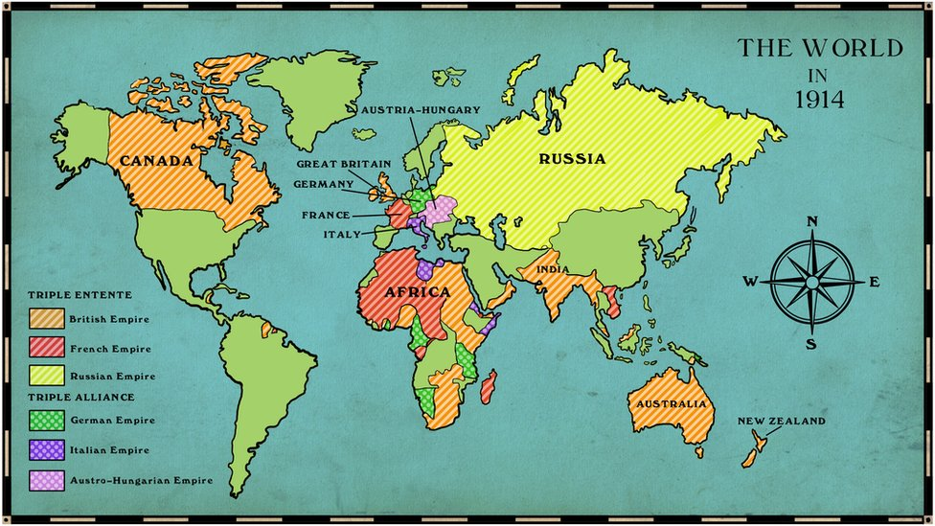
Empires in 1914
There were 6 major empires dominating the world in 1914.
They had divided themselves into alliances which were like teams or friendships, called the Triple Entente and the Triple Alliance.
These empires ruled most of the world and were very powerful.

Slide 6
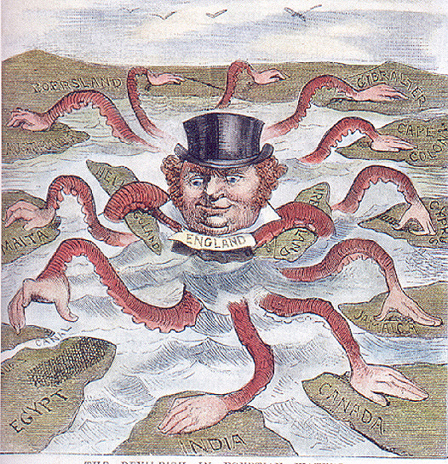
Imperialism
Building an empire by taking over other people’s land by force, is called IMPERIALISM

Slide 7
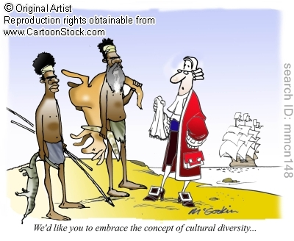
Colonialism
If you use these new lands to build up the resources of the mother country, it is called COLONIALISM

Slide 8
The following slide is a clear example of Imperialism and Colonialism.

Slide 9
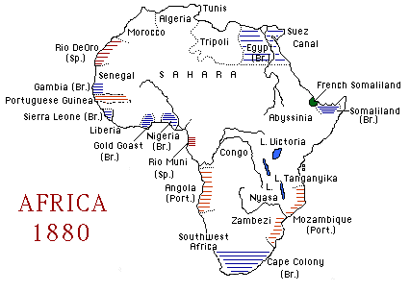
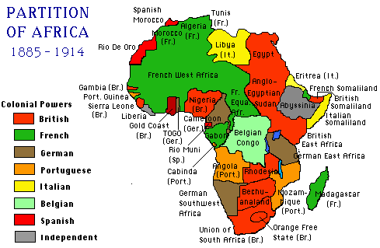
Africa
In 1880 very little of internal Africa had even been mapped.
Between 1885 and 1914 it was explored, divided and claimed by the major empires.

Slide 10
Why do we need to understand this????
How would you feel if you were sitting in your village minding your own business and some crazy in a uniform came and started telling you what to do?
What about if your family had just been told that they were no longer Bosnian. Now you were Austrian?
What about if Victoria was taken over and you just became Tasmanian?
Notes:
What I am getting at is that you would be angry and that is exactly what happened. We need to understand how the people and the governments of these countries were feeling at this time because it helps to explain their actions.

Slide 11
How did this lead to war?

Slide 12
Empire building
The major European countries are scrambling for land and power. (Imperialism)
Land taken over
Proud people and governments getting angry at losing control over their own lives. (Nationalism)
Security threatened
Countries/empires build up military strength. (Militarism)
Poor Leadership
Strengthen alliances
Leaders argue about who is more powerful

Slide 13

WW1!

Slide 14
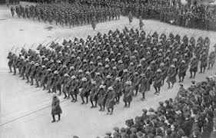
Militarism
Militarism is the government policy of building up large military forces

Slide 15
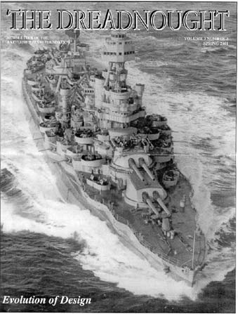
Militarism 1.
Germany was competing with the UK to build battleships.
The British feared an attack on their Empire

Slide 16
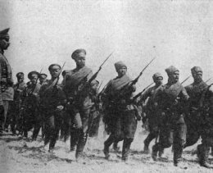
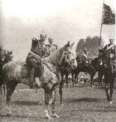
Militarism 2.
Germany was competing with Russia and France to expand their armies
        1880 1914
Germany 1.3m 5.0m
France 0.73m 4.0m
Russia 0.40m 1.2m

Slide 17
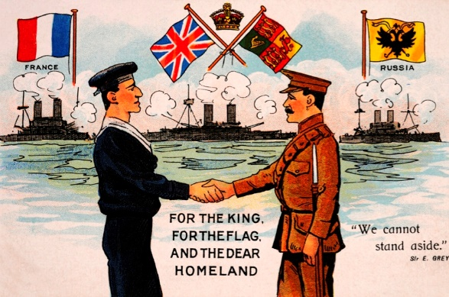
Alliances
Agreements made between one or two countries to support each other.
Alliances can be either economic or military and in WW1 they were mostly military.

Slide 18
Alliances
By 1914 all the major powers were linked by a system of alliances.
The alliances made it more likely that a war would start.
Once started, the alliances made it more likely to spread.

Slide 19
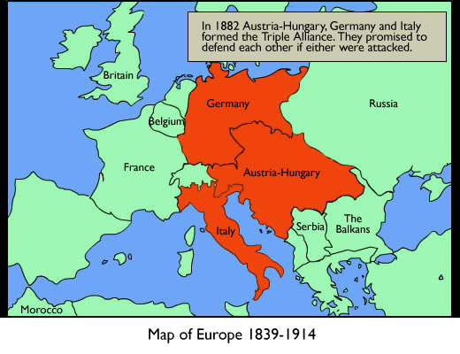
The Triple Alliance

Slide 20
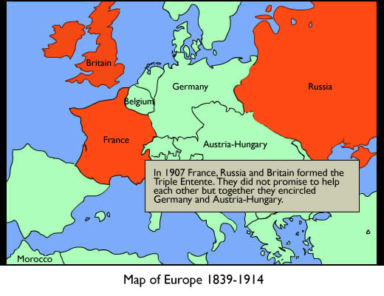
The Triple Entente

Slide 21

Nationalism
This was an age when all nations wanted to assert their power and independence.
In Europe Slavs, aided by Serbia and Russia, wanted to be free of Austrian rule.
Serbia’s national flag

Slide 22
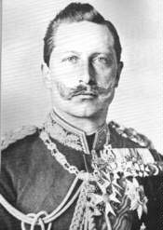
Significant/stupid Individuals
Kaiser Wilhelm II
Built up German army and navy
Aggressive foreign policy
Determined to make Germany a top nation.
Distrusted by other powers
“Germany must have its place in the sun”
“The world belongs to the strong.”

Slide 23
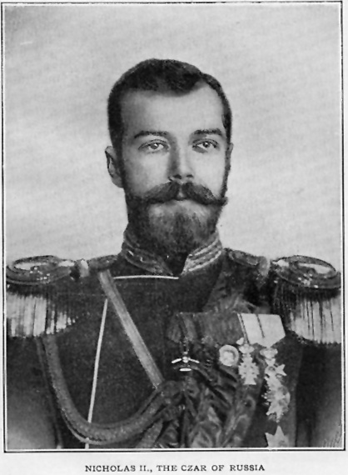
Tsar Nicholas II
Queen Victoria’s Grandson-in-law
Tsar of Russia – ruler of 166 million people
Weak leader – made many poor decisions.

Slide 24
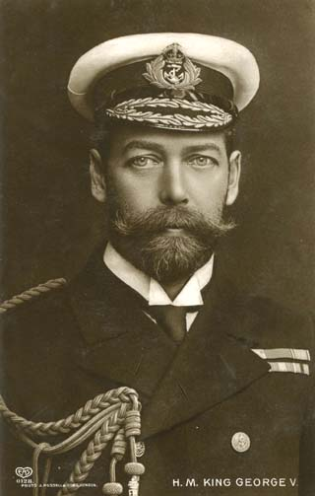
King George V
Head of the British Empire
King of England
He had a good rapport with the troops.
In 1917 he changed the family name from ‘Saxe-Coburg-Gotha’ to ‘Windsor’.

Slide 25
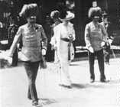

The Trigger.
28 June 1914
Heir to Austrian throne Franz Ferdinand visits Sarajevo.
Capital of Bosnia, recently grabbed by Austria.
Hotbed of Slav nationalism
Seal of the Black Hand group

Slide 26
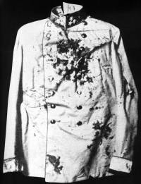
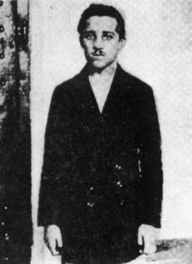
The Trigger.
“Black Hand” terrorists attack the Arch Duke
Bomb attempt fails in morning
Gavrilo Princip shoots Archduke and wife in the afternoon.
Austrians blame Serbia for supporting terrorists.

Slide 27
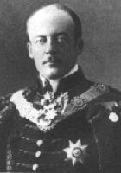
The Response.
“Demands must be put to Serbia that would be wholly impossible for them to accept …”
Austrians, supported by Germany, send Serbia a tough ultimatum.
Serbia agrees to all but two terms of the ultimatum.
Russia mobilises her troops to support Serbia
Germany demands that Russia stands her armies down.
Germany declares war on Russia

Slide 28
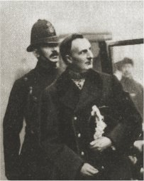
Why did Britain get involved?
Britain had Ententes with France and Russia.
Only “friendly agreements” but French and Russians given impression Britain would fight.
The Schlieffen Plan
Sir Edward Grey
British Foreign Secretary … “There’s some devilry going on in Berlin”

Slide 29
The Schlieffen Plan
In 1914, Germany believed war with Russia was extremely likely. If war broke out, Germany assumed France would also attack as she was both an ally of Russia and keen for revenge for her defeat in the Franco-Prussian war.
If this happened, Germany would face a war on two fronts. Germany wanted to avoid this at all costs.
Germany planned to defeat France rapidly and then turn to the eastern front for a major offensive on Russia. This was the basis for the Schlieffen Plan.

Slide 30
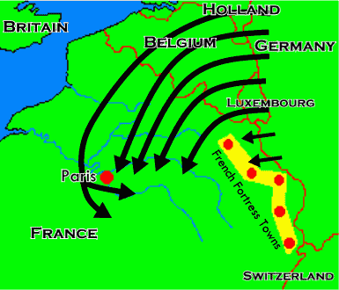
How Germany Invaded France

Slide 31
German Assumptions
Russia would take at least 6 weeks to mobilise.
France would be easily defeated in 6 weeks.
Belgium would not resist any German attack.
Britain would remain neutral.

Slide 32
They were WRONG!
The Reality
On 2nd August 1914, the German army invaded Luxembourg and Belgium according to plan.
BUT
The Germans were held up by the Belgium army, backed up by the British Forces who arrived extremely quickly.

Slide 33
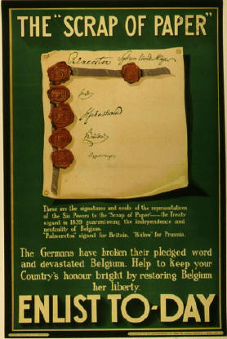
Britain’s Reaction
1838- UK had signed a Treaty to protect Belgium.
Britain also scared of Germany controlling Channel ports.
Did not want Germany to defeat France and dominate Europe. Britain next?
UK issued ultimatum to Germany to withdraw troops from Belgium.
War declared August 4 1914

Slide 34
Just to add to their problems…
Russia mobilised in just 10 days and Germany was forced to withdraw troops from the Schlieffen Plan to defend her eastern border.
Germany did not take Paris. They were met by French troops at the battle of the Marne (5-11 Sept) which halted the German advance.
The Schlieffen Plan's assumptions had been flawed

Slide 35
Which goes to show…
You should never assume anything because it will make an
ASS out of U and ME

Slide 36
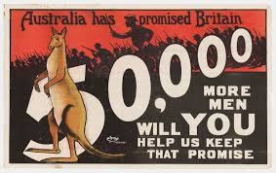
Australia goes to war
When WW1 broke out in 1914, Australia had only been a nation for 13 years (following federation). It was grappling with major political, social and economic changes. Yet it’s ties with Britain remained very strong.

